Slide 1
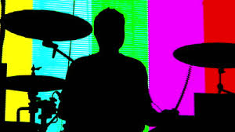
Basics of Digitized Sound

Slide 2
Sound Waves
An object (think of a cymbal) creates sound by vibrating in a medium such as air.
The vibrations push the air, causing pressure waves which vibrate our eardrums.
The force of the push determines the volume.
The frequency(number of waves per second) determines the pitch.

Slide 3
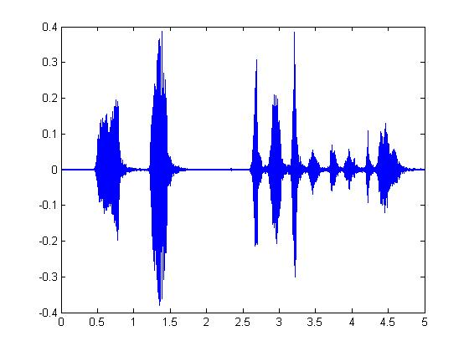
Sound Wave Graph: JFK saying, “Ask NOT what your country can do for you…”

Slide 4
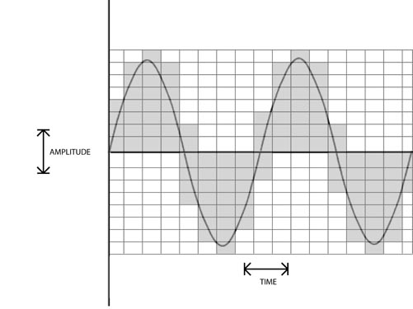

Slide 5
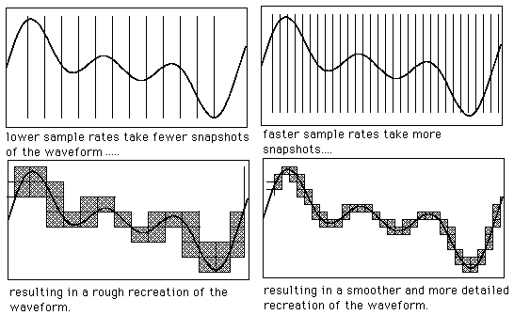

Slide 6
Sampling Rate
Sampling rate is the number of samples taken in one second. The faster the rate, the more accurately the wave is recorded.
The Nyquist rule says that a sampling rate must be at least twice as fast as the fastest frequency.
Human perception can hear sound up to about 20,000 Hz.
Today, the common sampling rate for a high quality digital recording is 44,100 Hz.
Read more: http://www.trustmeimascientist.com/2013/02/04/the-science-of-sample-rates-when-higher-is-better-and-when-it-isnt/

Slide 7
Digitized Sound
Key advantage: can compute on the digital representation:
Compression (MP3 gives ratio of 10 to 1)
Filter out noise
Speed up or slow down performance
Can make exact copies of original
Quality depends on sampling rate
Voice communication, sampling rate of 8,000 per second is sufficient
High quality musical recordings require sampling rate of 44,100 per second

Slide 8
Digitized Sound
16 bits for each sampled value: 2¹⁶= 65,536 different levels. 32,767 positive values; 32,768 negative values
Sampling rate for digitized audio: 44,100 Hz (samples per second)
For one minute of audio: 60 seconds * 44,100 samples * 16 bits * 2 for stereo = 84,672,000 bits = 10,584,000 bytes 10 meg
For one hour of audio (uncompressed): 60 mins* 10 meg = 600 meg

